Slide 1
Higher Order PCM

Slide 2
HIGHER ORDER PCM SYSTEMS
CONCEPTS
BIT INTERLEAVING
BYTE INTERLEAVING
PDH HEIRACHY
PDH CONCEPTS
THE DISADVANTAGE OF PDH

Slide 6
Pleslouronus Digital Multiplexing
2/8
8/34
34/140
140/620
First Order or primary order
Second Order
Third Order
Fourth Order
Fifth Order
488
117
25
7
1.7

Slide 7
SYNCRONASE DIGITAL HEIRHACHICAL SYSTEMS
SDH CONCEPTS
HOW CONTAINERS AND VIRTUAL CONTAINERS ARE FORMED
PATH OVERHEAD AND POINTERS
ADVANTAGE OF SDH
HIGHER ORDER SDH SYSTEMS

Slide 9
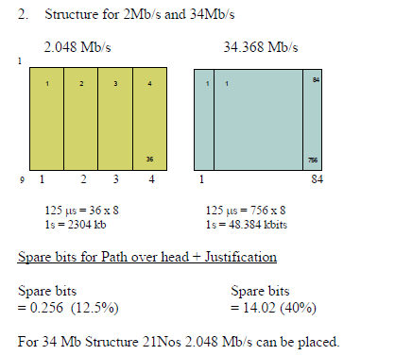
BASIC CONTAINERS C12,C3

Slide 10
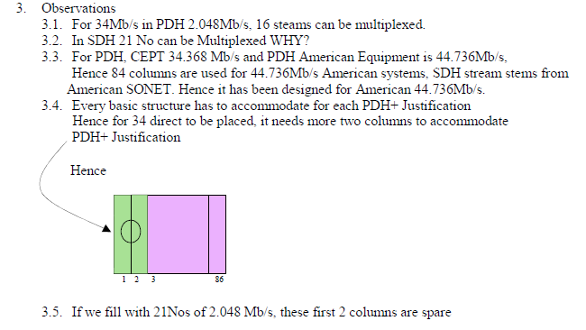
CHARACTERISTICS OF BASIC CONTAINERS

Slide 11
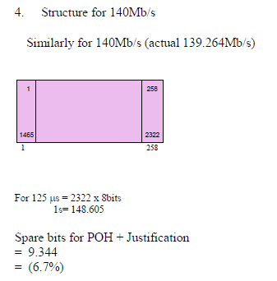
C4 CONTAINER

Slide 12
BASIC COMPARISION OF PDH & SDH

Slide 13
HOW PACKING THE CONTAINERS ACHIEVED

Slide 14
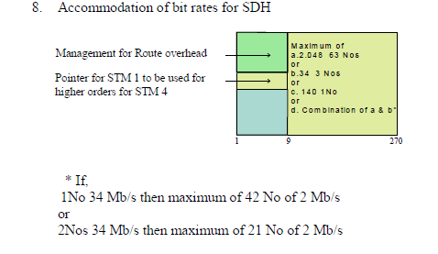
BASIC STRUCTURE OF THE STM1

Slide 15
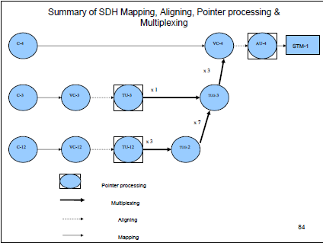
BASIC SDH MAPPING

Slide 16
Technological Evolution (Fill the blanks)
Multiplex Level | Speed | Period of the Pulse | No: of voice channels
STM1
STM4
STM16
STM64
STM256

Slide 17
Technological Evolution at a glance
Multiplex Level | Speed | Period of the Pulse | No: of voice channels
STM1 | 155.52Mbps | 6.4ns | 1890
STM4 | 622.08Mbps | 1.6ns | 7560
STM16 | 2.5Gbps | 400ps | 30240
STM64 | 10Gbps | 100ps | 120960
STM256 | 40Gbps | 25ps | 483840

Slide 18
HIGH RELIABILITY NETWORKS

Slide 19
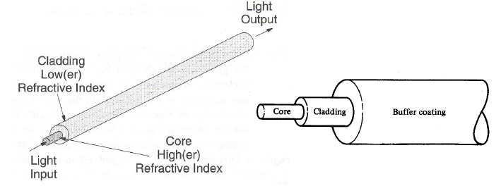
Optical Fibre
An optical fibre consists of two parts → the core and the cladding
The core is a narrow cylindrical strand of glass and the cladding is a tubular jacket surrounding it
The core has a (slightly) higher refractive index than the cladding
Therefore, total Reflection of light → n_{core} > n_{cladding}

